Slide 1
DOCSGUIDE An Assistant for Government Document Procedures

Slide 2

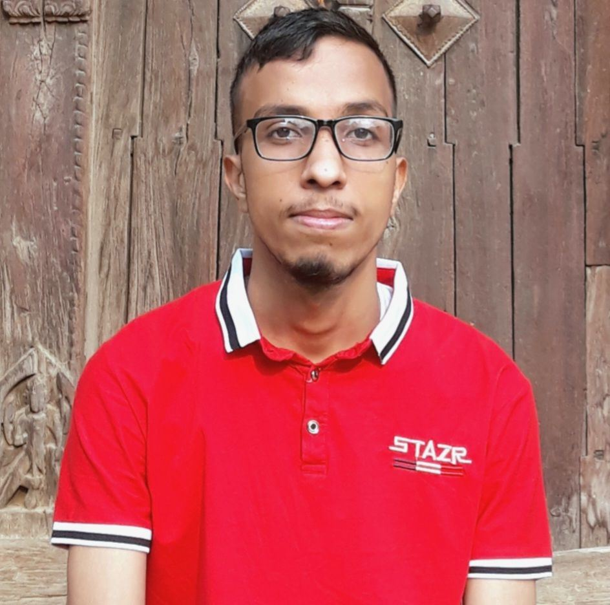


Team Members
Andis Paudel
Bikash Pokhrel
Dipin Adhikari
Utsab Dahal
Data Ingestion &
Embeddings
Retriever Design &
RAG Evaluation
Web App &
Retriever Design
Generator Design &
RAG Evaluation

Slide 3
Project Overview
DocsGuide is an AI chatbot that helps Nepali citizens in understanding government document procedures such as obtaining citizenship certificates, passports etc.
It uses a Retrieval-Augmented Generation (RAG) model to deliver accurate, step-by-step guidance based on verified official sources.
The system supports both Nepali and English, ensuring accessibility for diverse users.
Users can ask questions or seek legal information related to government documents.

Slide 4
Problem Statement
Complex and confusing government procedures
Inconsistent and unclear information
Lack of centralized guidance system
Need for conversational AI based assistance

Slide 5
Objectives
1
To develop an AI chatbot that guides users through government document procedures.
2
To provide accurate, verified, and bilingual information for document related queries.
3
Evaluate system performance based on accuracy and response quality.

Slide 6
Methodology
1. Document Collection and Chunking
Collected and preprocessed verified government documents related to citizenship and passport procedures (acts, rules, FAQs, guidelines).
Applied chunking strategies for efficient retrieval:
Section-based chunking for structured division.
Metadata assignment — document type, references, section/subsection, tags (question category), and source links.

Slide 7
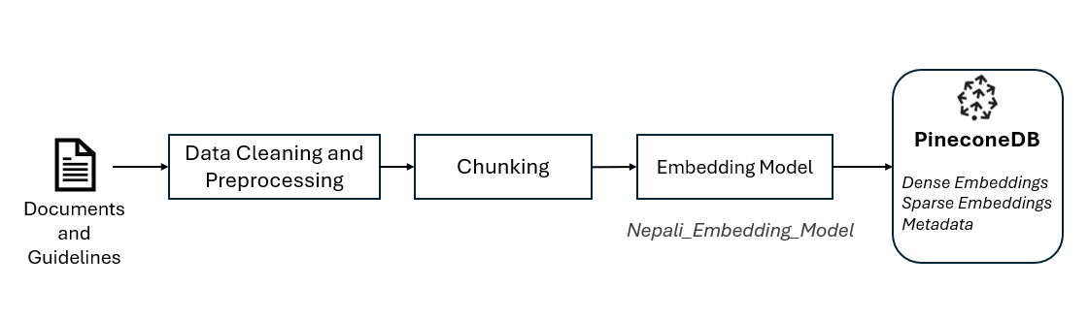
Methodology
2. Embedding Generation and Storage
Embedding Model universalml/Nepali_Embedding_Model with:
Maximum sequence length: 512 tokens
Output dimensionality: 1024
Generated & Stored dense embeddings with metadata in PineconeDB.
Sparse vector representations using BM25 encoder to support keyword-based search.

Slide 8
Methodology
3. Retriever Design
Multiple retrieval strategies:
Pure Dense Search — similarity search using dense embeddings only.
Hybrid Search — combination of dense embeddings and keyword-based BM25 search( Controlled by alpha parameter)
Metadata-based Filtering — filtered chunks by document type, tags.
Cross-Encoder Reranking — refined top results using cross encoder model (jinaai/jina-reranker-v2-base-multilingual) for higher relevance.
Query Translation and Rewriting Layer — translates queries to Nepali, includes chat context, and detects language.

Slide 9
Methodology
4. Generator Design
Language-Aware Response Generation : Gemini API to generate answers with given context in the detected language.
Source Citation : Cite references for retrieved information.
5. Web App Design
Frontend: Next.js & Tailwind CSS.
Backend: FastAPI

Slide 10
Methodology
6. Evaluation and Testing
Evaluation Dataset: 28 question & answer pairs.
Testing Dataset: 15 question & answer pairs.
Manually labelling of relevant document chunks for each question to serve as ground truth.
RAG evaluation pipeline to calculate metrics :
Recall – proportion of relevant chunks retrieved
Precision – proportion of retrieved chunks that were relevant,
Answer Correctness – accuracy of generated responses against labeled data.

Slide 11
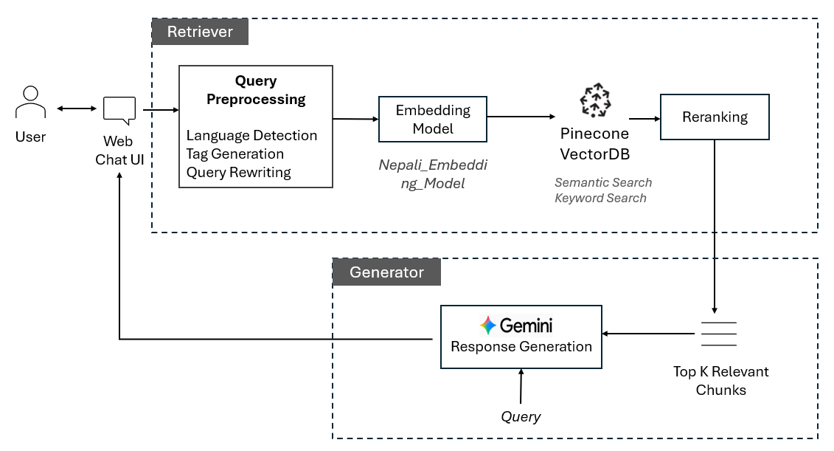
System Design
System Architecture

Slide 12
Results
Evaluation Configuration | Metrics
Without Metadata Filtering and without re-ranking
Pure Dense Search Top 3 used for Generation | Answer Correctness: 78.92% Recall@7 : 89.94% Precision@7: 21.93%
Hybrid Search 50% Dense and 50% Sparse Top 3 used for Generation | Answer Correctness: 83.14% Recall@7 : 90.23% Precision@7: 21.93%
Hybrid Search 75% Dense and 25% Sparse Top 3 used for Generation | Answer Correctness: 84.10% Recall@7 : 90.23% Precision@7: 21.93%

Slide 13
Results
Evaluation Configuration | Metrics
Without Metadata Filtering and with re-ranking
Hybrid Search (50% Dense and 50% Sparse) Document type only meta data filter Top 3 used for Generation | Answer Correctness: 85.77% Recall@7 : 90.23% Precision@7: 21.93%
With Metadata Filtering and with re-ranking
Hybrid Search (50% Dense and 50% Sparse) Document Type and Tag based filter Top 3 used for generation | Answer Correctness: 82.52% Recall@7 : 75.7% Precision@7: 19.2%
Testing Dataset
Hybrid Search (50% Dense and 50% Sparse) Document type only meta data filter Top 3 used for Generation | Answer Correctness: 89.3% Recall@7 : 88.9% Precision@7: 21.0%

Slide 14
Conclusion
Successfully developed a bilingual RAG-based chatbot to assist users with Nepali government document procedures.
Ensured accurate and verified responses using official sources and hybrid retrieval strategies.
Hybrid search (50% vector + 50% keyword, with reranking) achieved around 90% recall and 85% answer correctness.

Slide 15
Limitations
Limited to citizenship and passport only
Small evaluation dataset may not fully represent real user queries.
Lack of large-scale real user testing.
Semantic search limited to Nepali text, as the knowledge base was primarily in Nepali.
Translation inaccuracies.
Incorrect question tagging by Gemini when using tag-based filtering.

Slide 16
Challenges
Selection of chunking strategies based on document type and structure.
Balancing between keyword and semantic search to achieve optimal hybrid retrieval performance.
Semantic accuracy of embedding and re-ranking models

Slide 17
Future Works
Expand to more government documents.
Improve legal translation with external knowledge base and mixed-language handling.
Handle both English and Nepali knowledge bases for improved retrieval.

Slide 18
THANK YOU

